Slide 1
NERS 551 Nuclear Reactor Dynamics Winter, 2022 Lecture 8: Chapter 8 February , 2022 Prof. T. Downar

Slide 2
“Takeaways” from Lecture 8
“Big Picture”
Ch 5 Exact Point Kinetics (Eq. Eq. 5.34)
w/ assumptions -> Point Reactor Model
Ch 6
Simplify Delayed Neutron Source -> one group delayed neutrons
Application to CONSTANT reactivity insertion (ie NO FEEDBACK)
SOLUTION w/ one group delayed neutronics … Eq. 6.109
Subprompt
Superprompt
Ch 8 Time-dependent Reactivity -> Subprompt (e.g. MSLB)
Ch 10 Time-dependent Reactivity w/ Feedback -> Superprompt (CEA)
Prompt Jump Approximation (Eq. 8.10)
Analytic solution with linear time-dependent reactivity

Slide 3
Review Response to Subprompt Critical Reactivity
Very prompt multiplication of EXISTING delayed neutron source
“Asymptotic period” is the multiplication of the additional “built-up” delayed neutron source

Slide 4
Ch 8 Approximate Point Kinetics

Slide 5
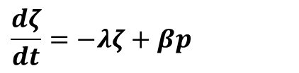
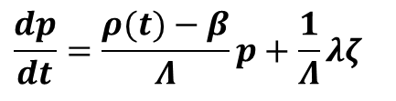
Sub-prompt critical w/ One-group kinetics equations
Prompt Jump Approximation - 1
$$\frac{dp}{dt}=\frac{ρ(t)−β}{Λ}p+\frac{1}{Λ}λζ$$
$$\frac{dζ}{dt}=−λζ+βp$$
Method of Singular Perturbations

Slide 6
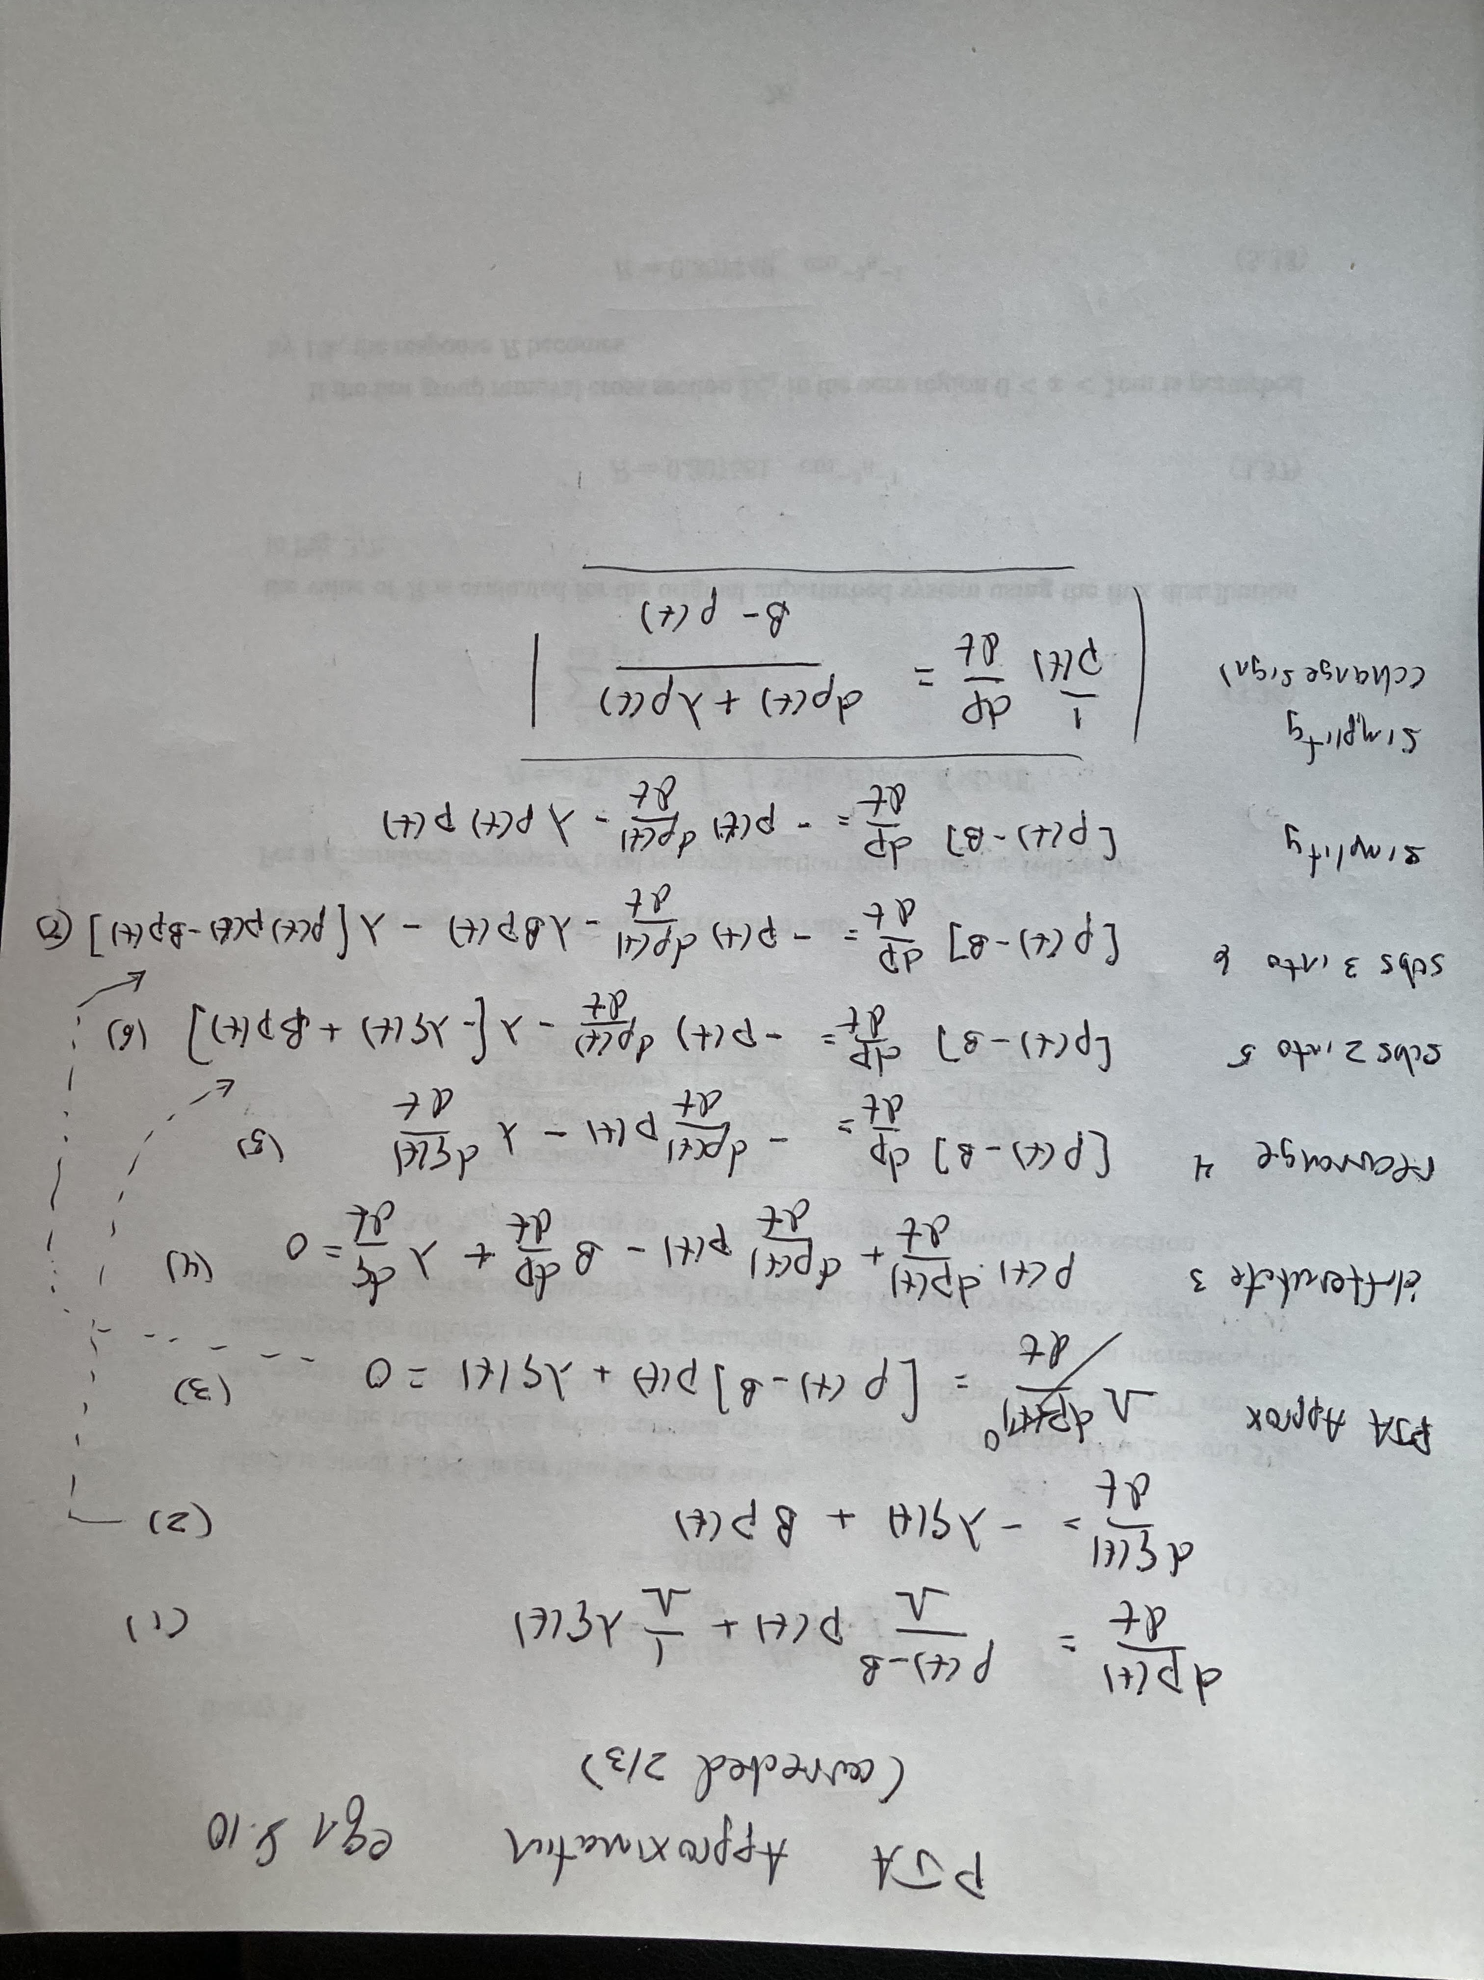
Derivation of PJA (Eqn. 8.10)
Eqn. 8.10

Slide 7
Derivation of PJA (Eqn. 8.10)
Singular Perturbation

Slide 8
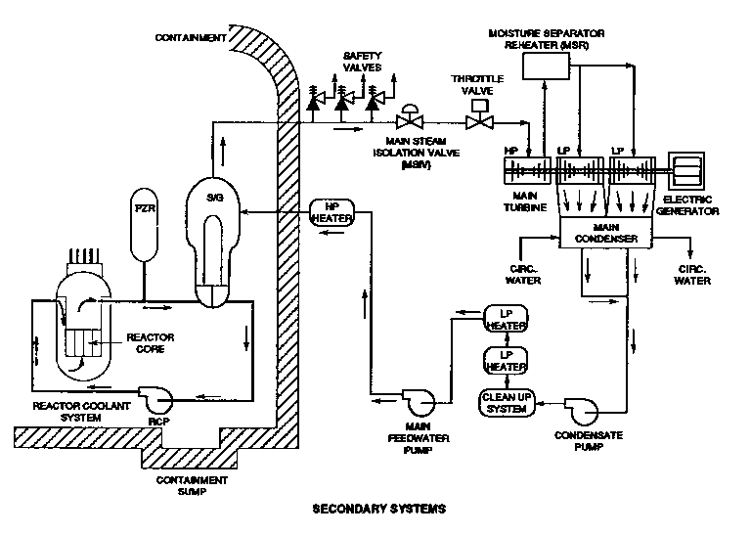
Nuclear Reactor Transient Analysis: PWR Main Steam Line Break
PWR Plant
Schematic
Notes:
8

Slide 9
Main Steam Line Break Transient: Core Coolant Temperature
Density
Doppler
Total
Control Rod
Notes:
9

Slide 10
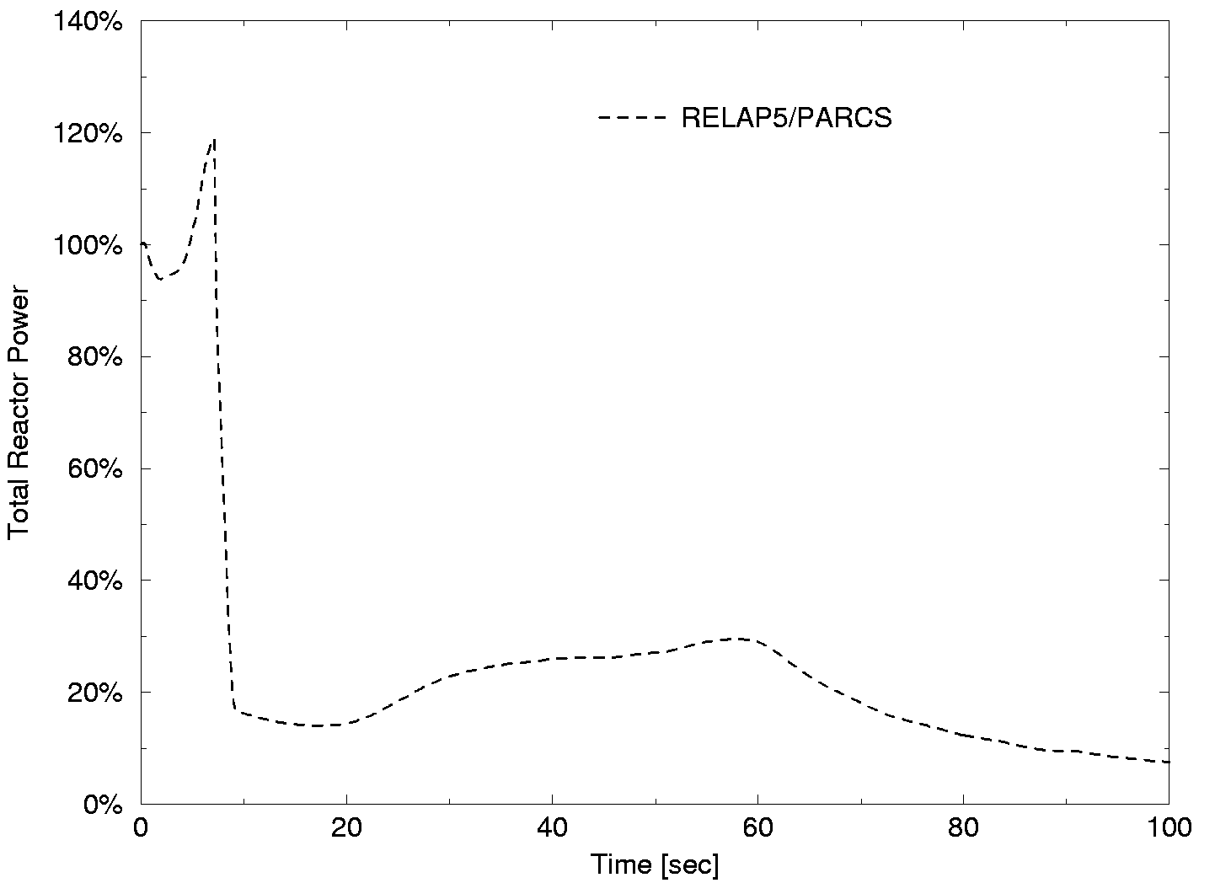
Main Steam Line Break Analysis: Core Average Power
Density
Doppler
Total
Control Rod
Notes:
10

Slide 11
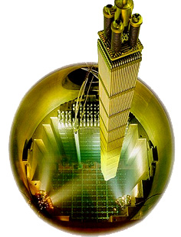
MSLB: Core 3D Neutronics Model
reflector
assembly
14
19
8
15
9
2
7
13
3
1
16
10
4
6
12
18
5
11
neutronic fuel
assembly
stuck rod
location
17
Notes:
11

Slide 12
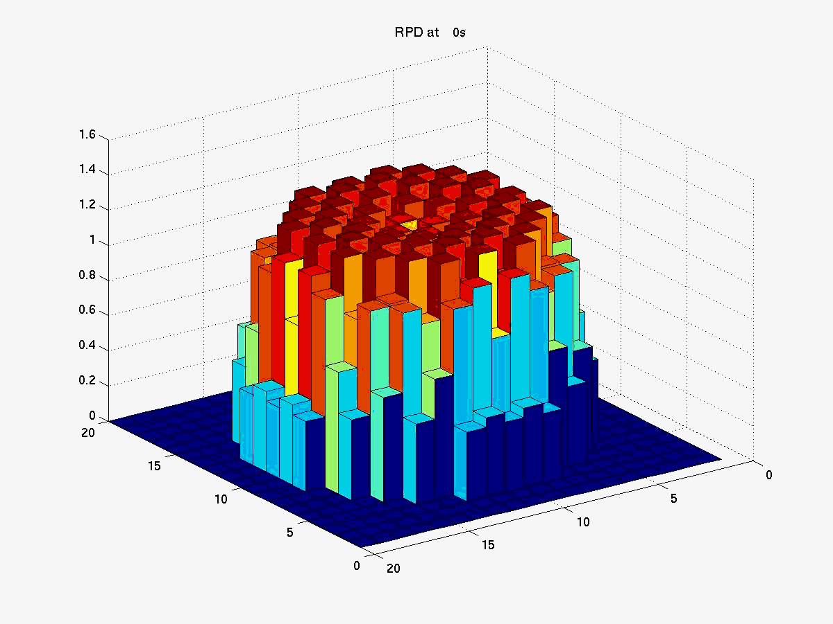
Three-Dimensional Analysis Main Steam Line Break
Initial Steady-State
Notes:
12

Slide 13
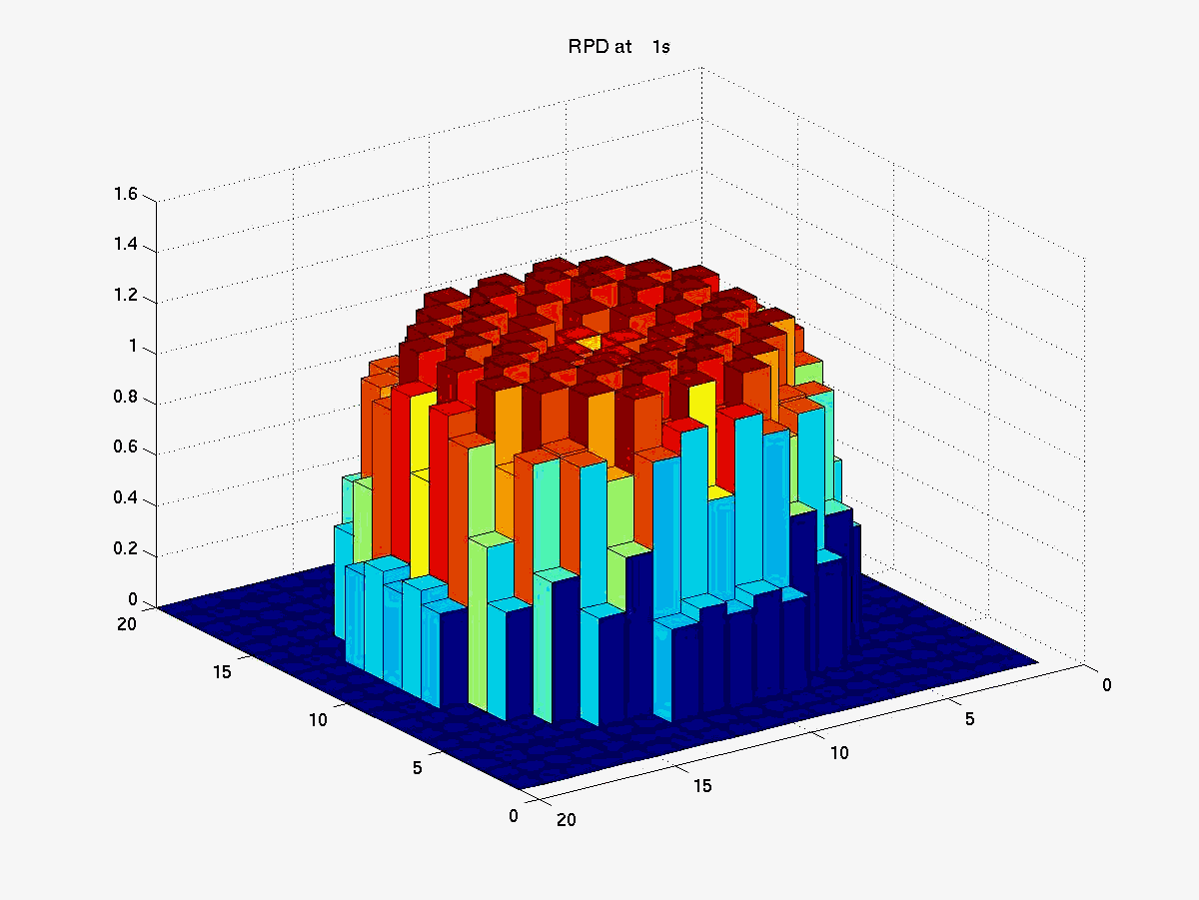
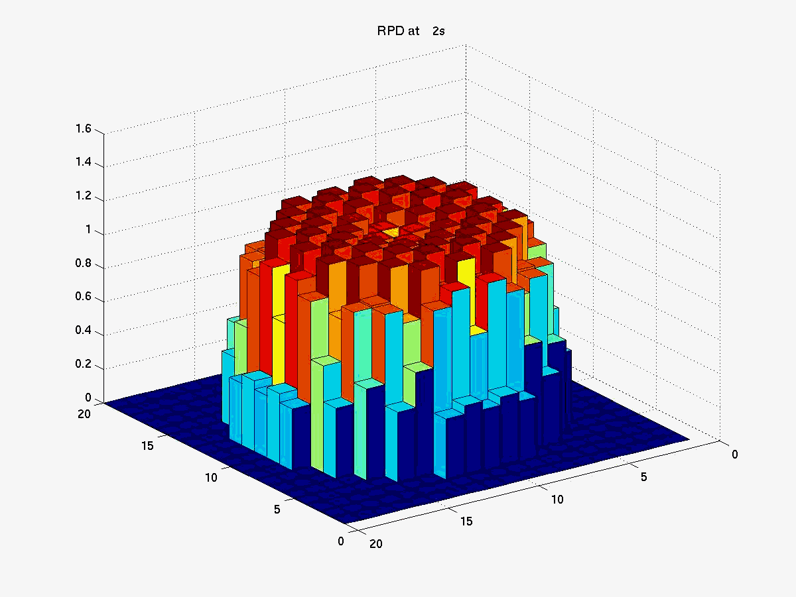

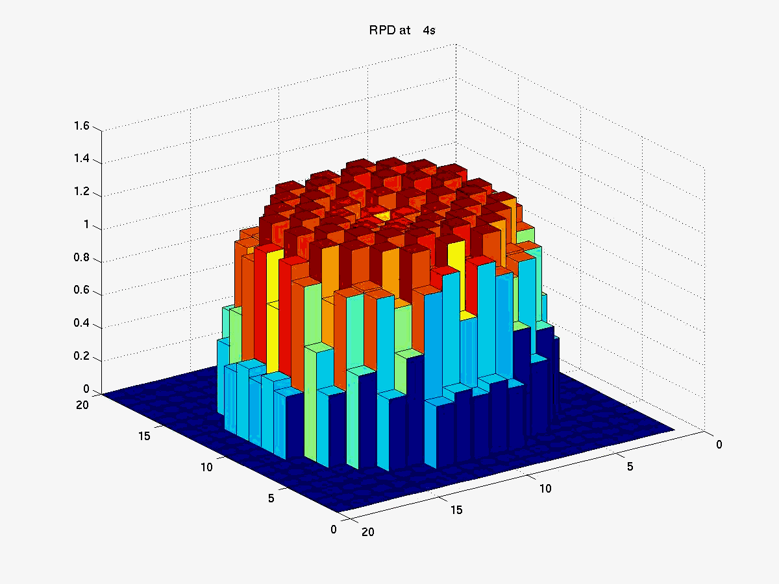
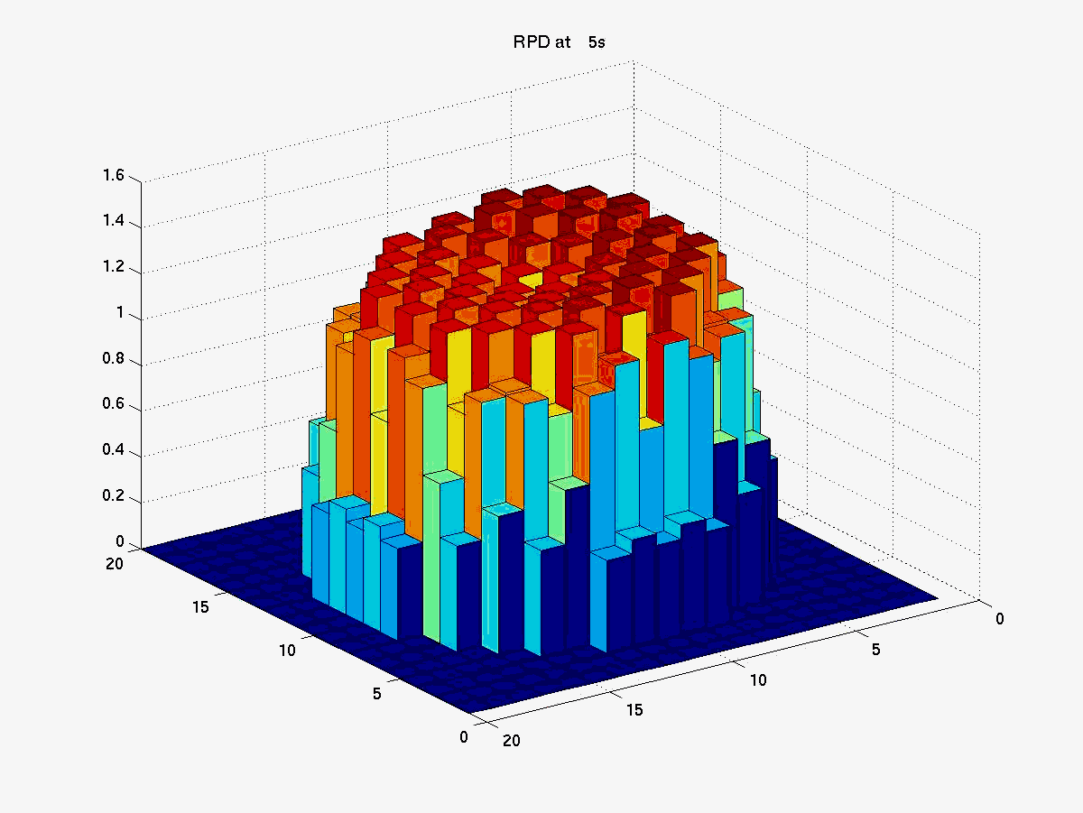
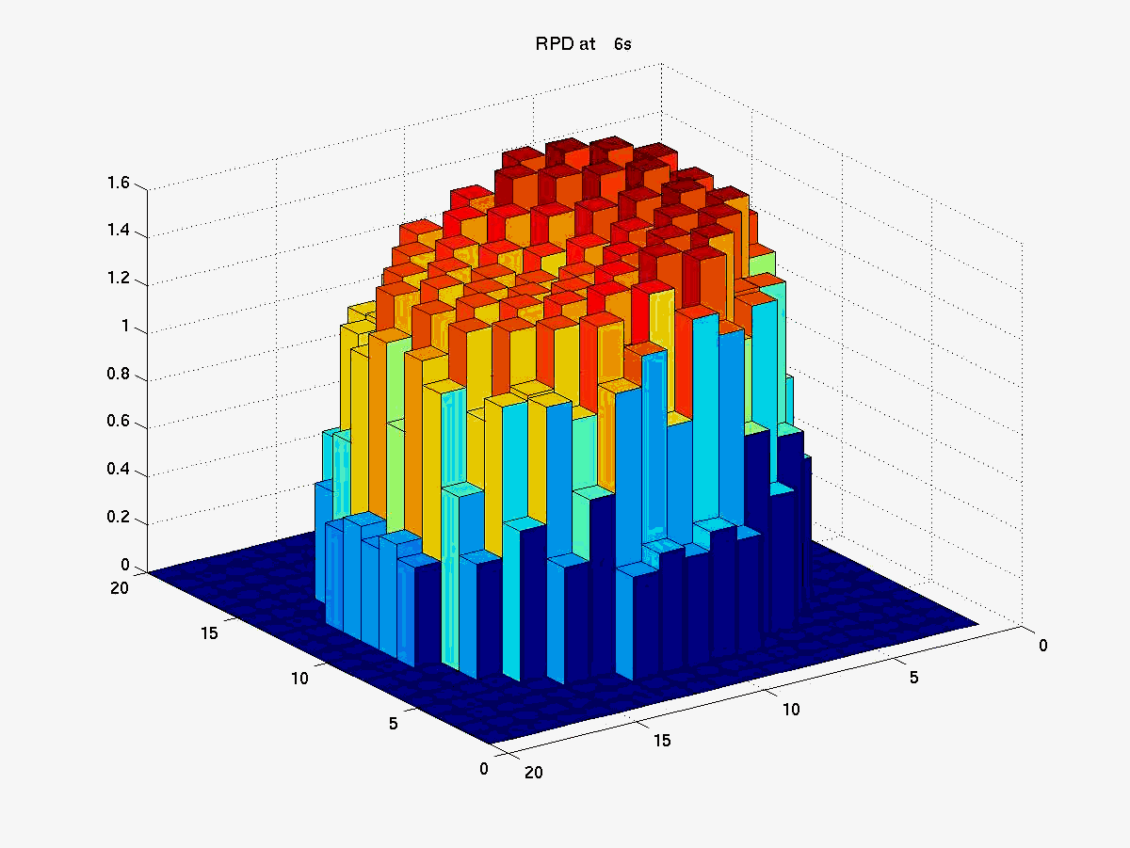
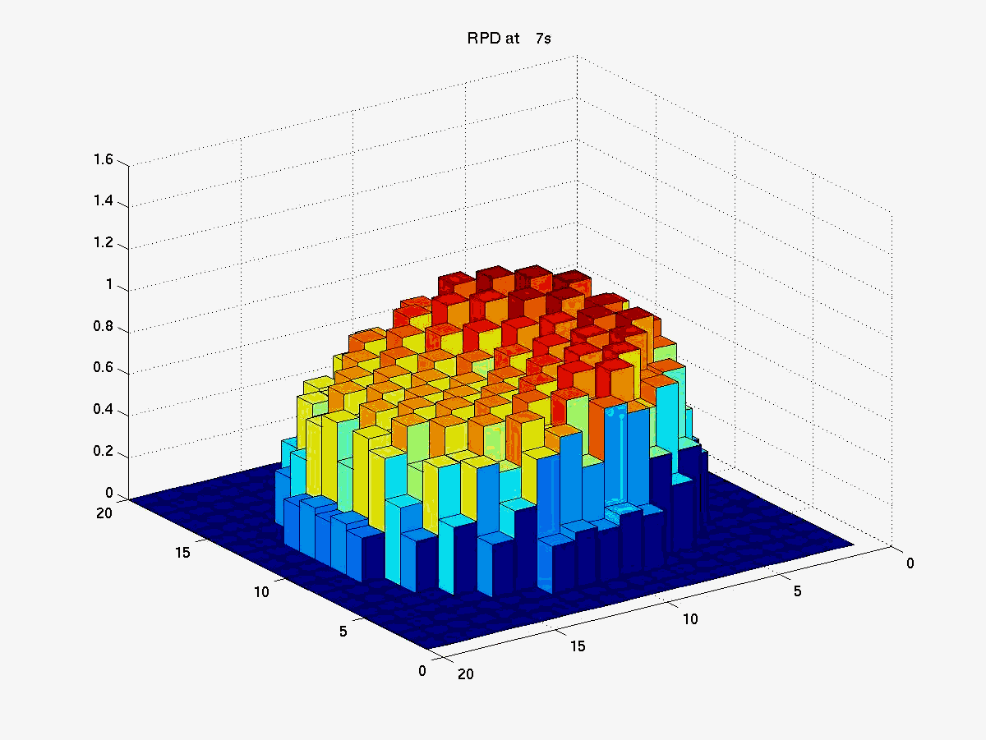
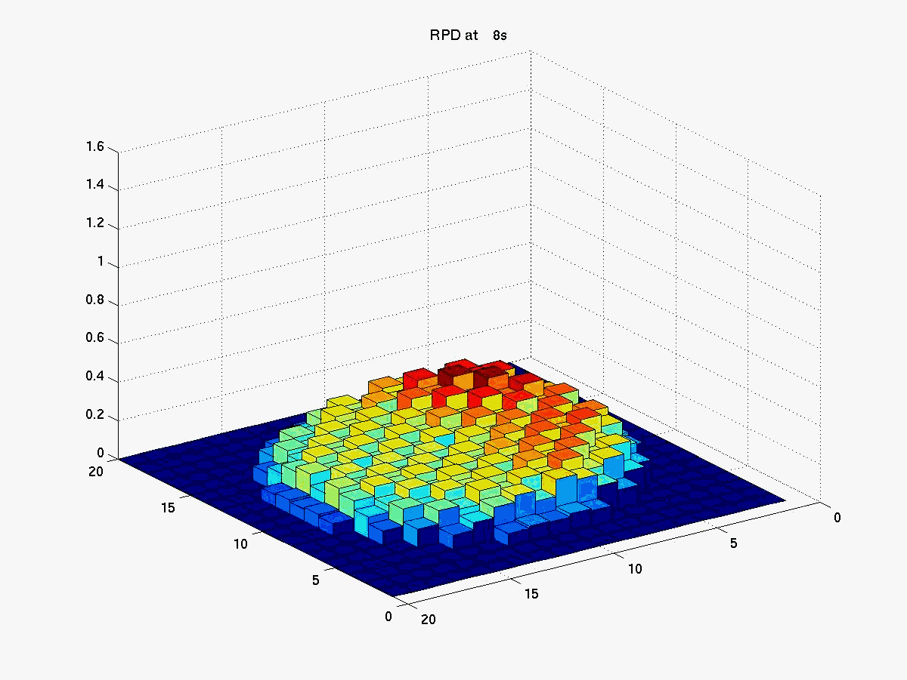
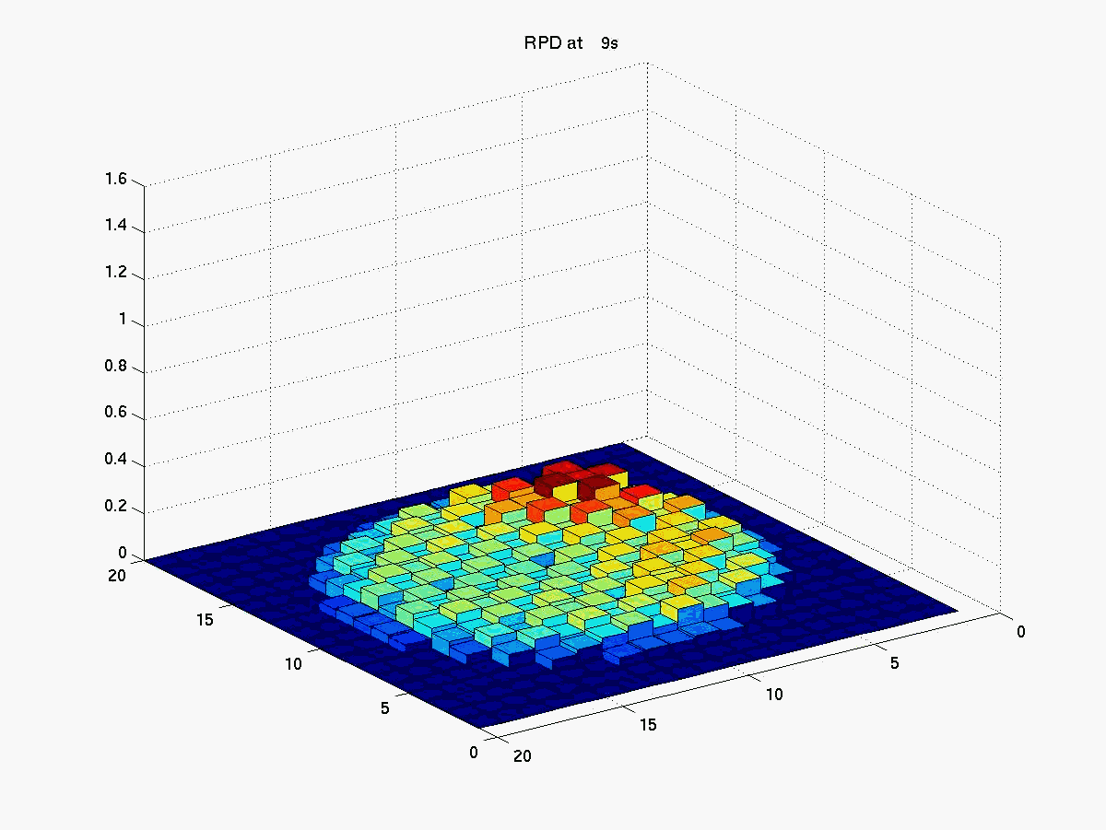
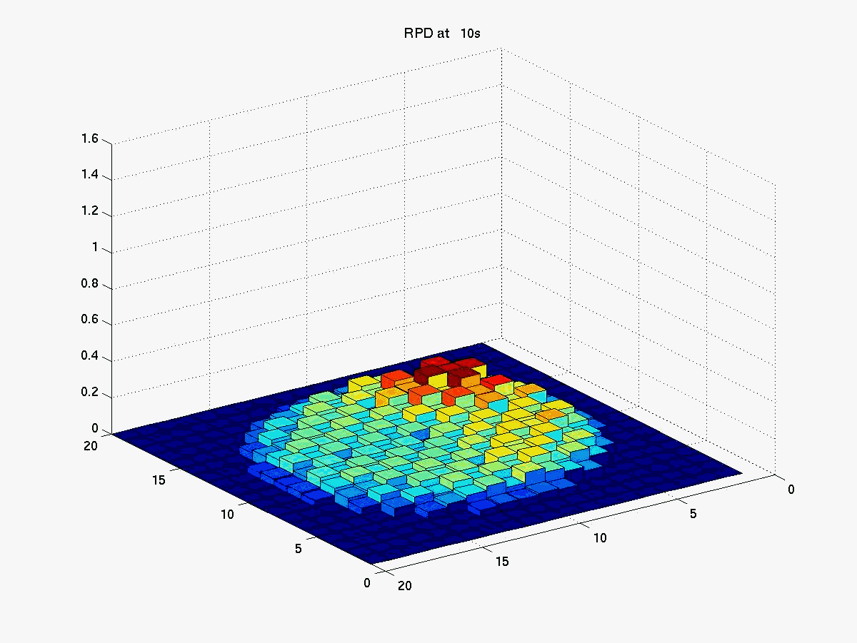
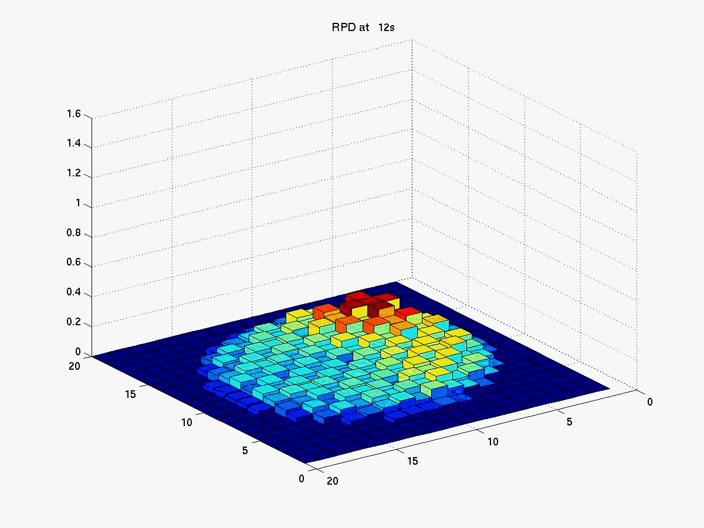
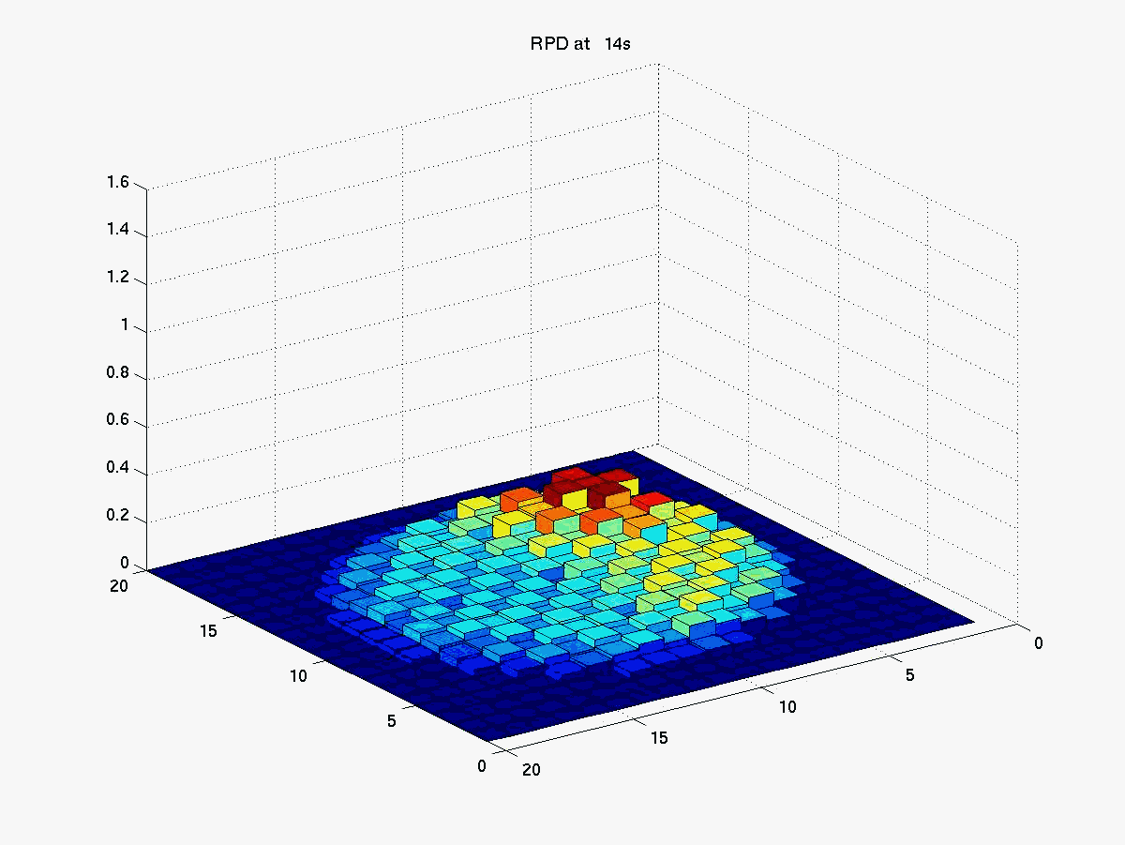
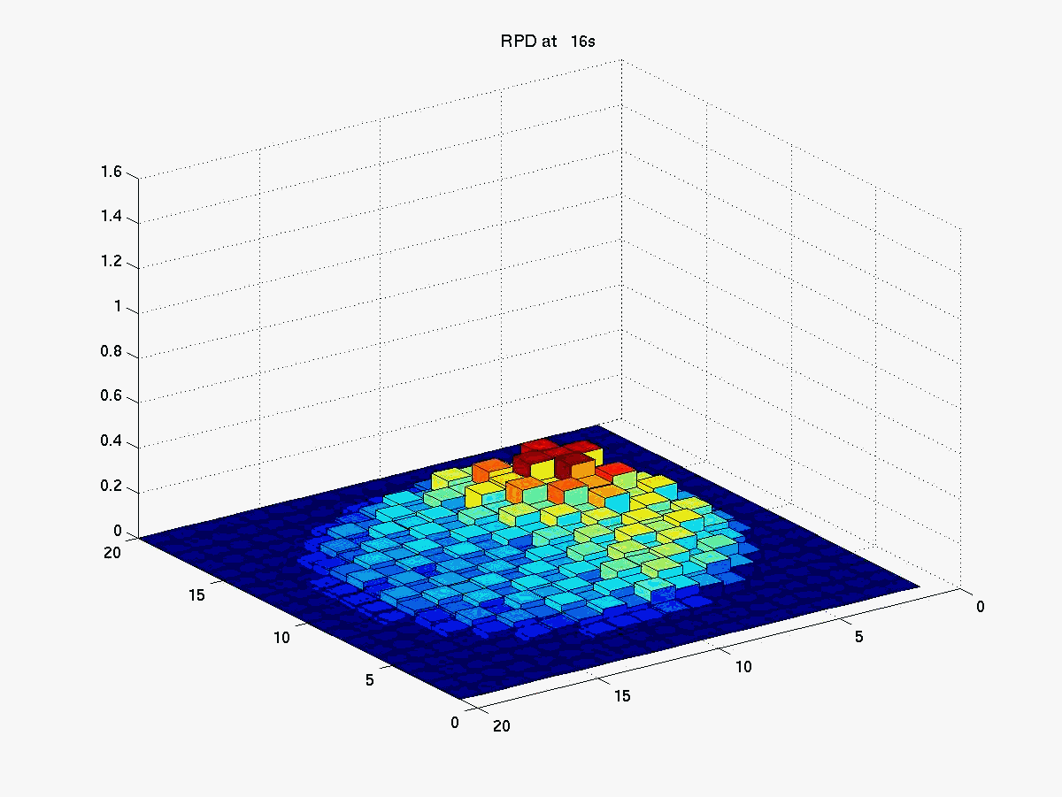
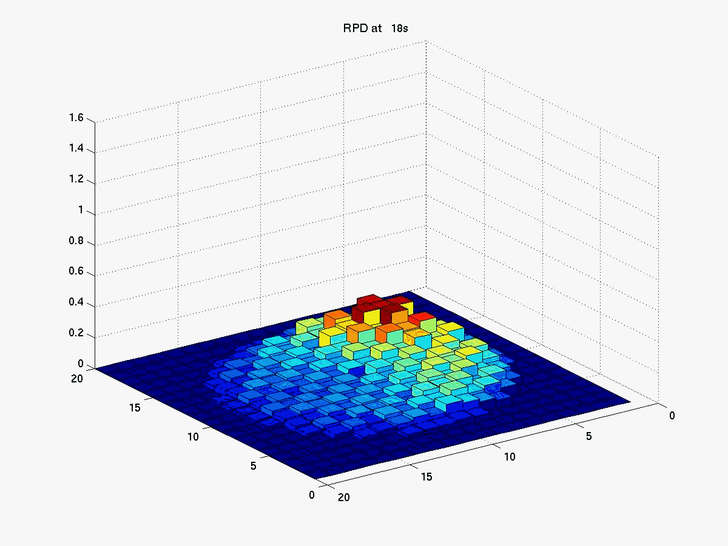
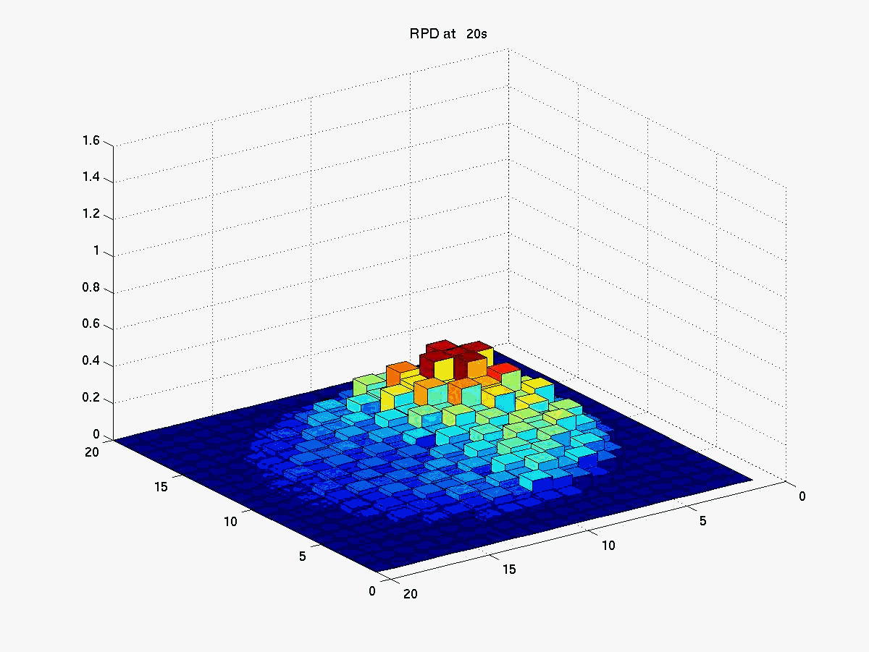
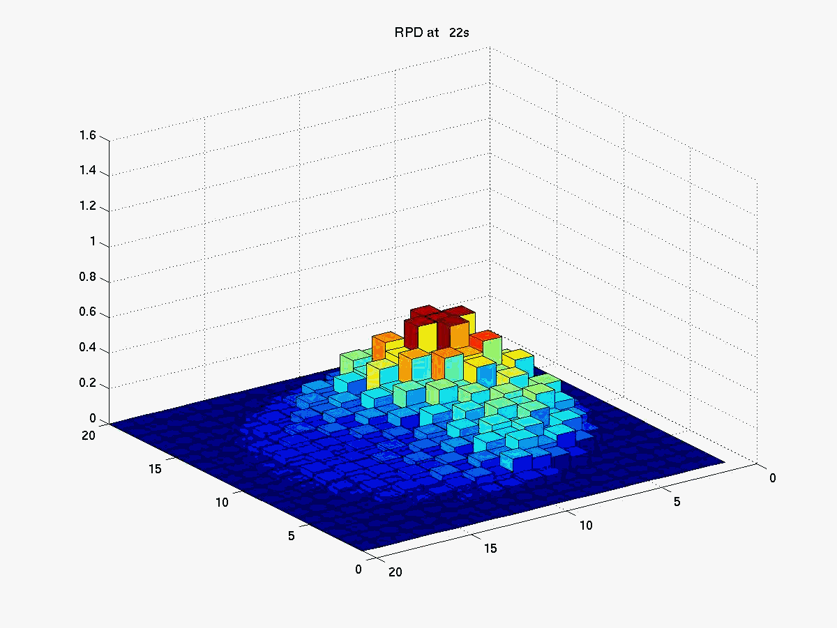
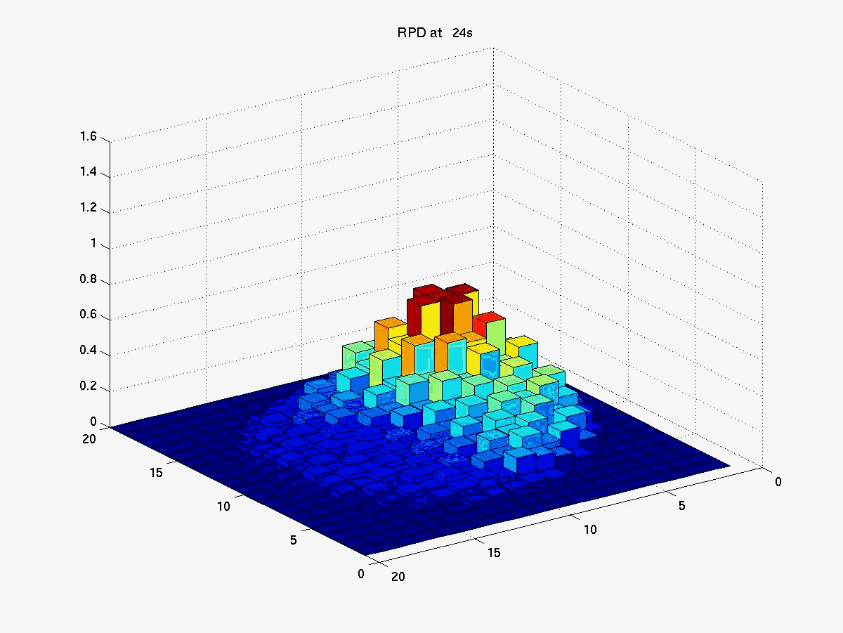
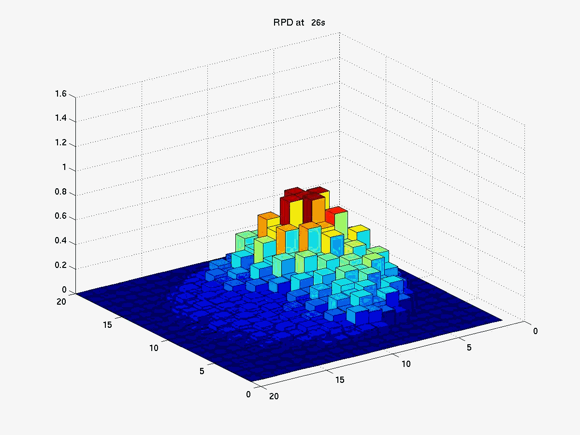
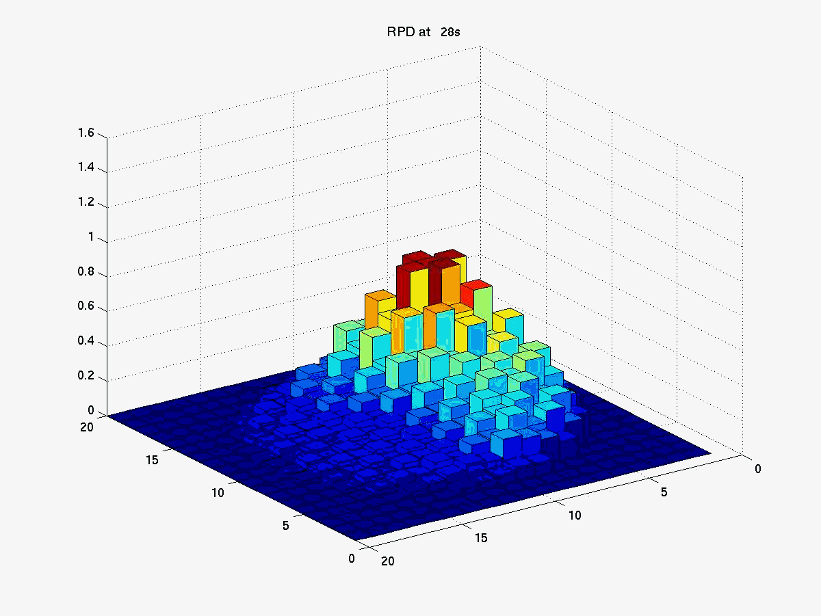
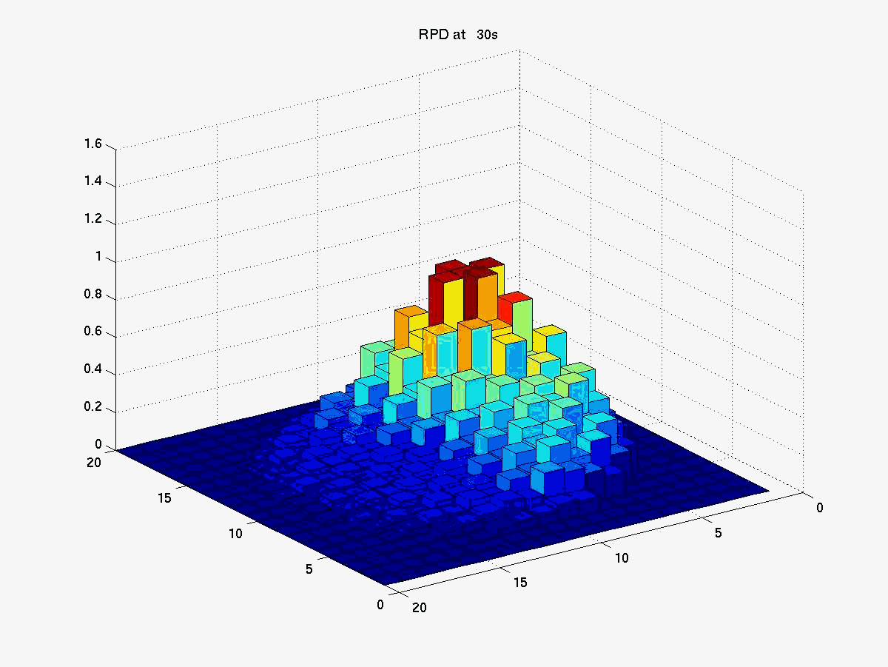
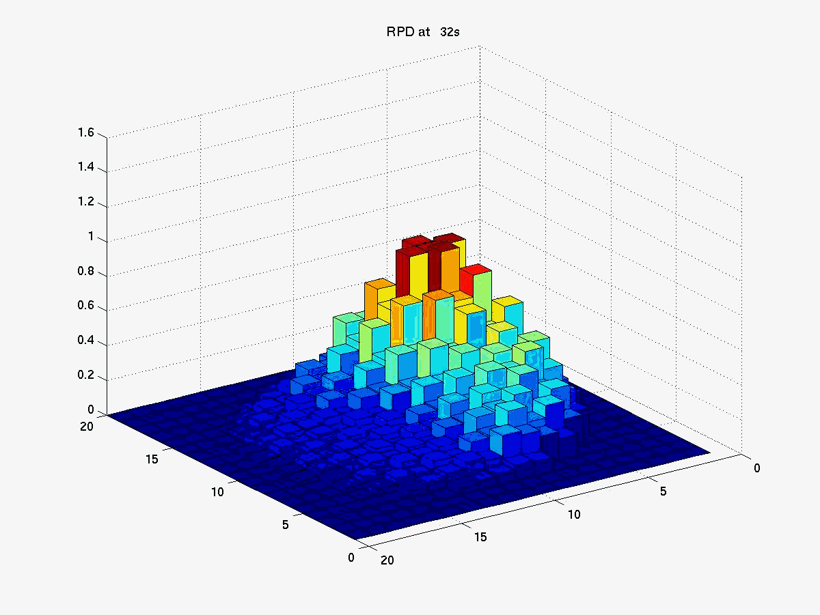





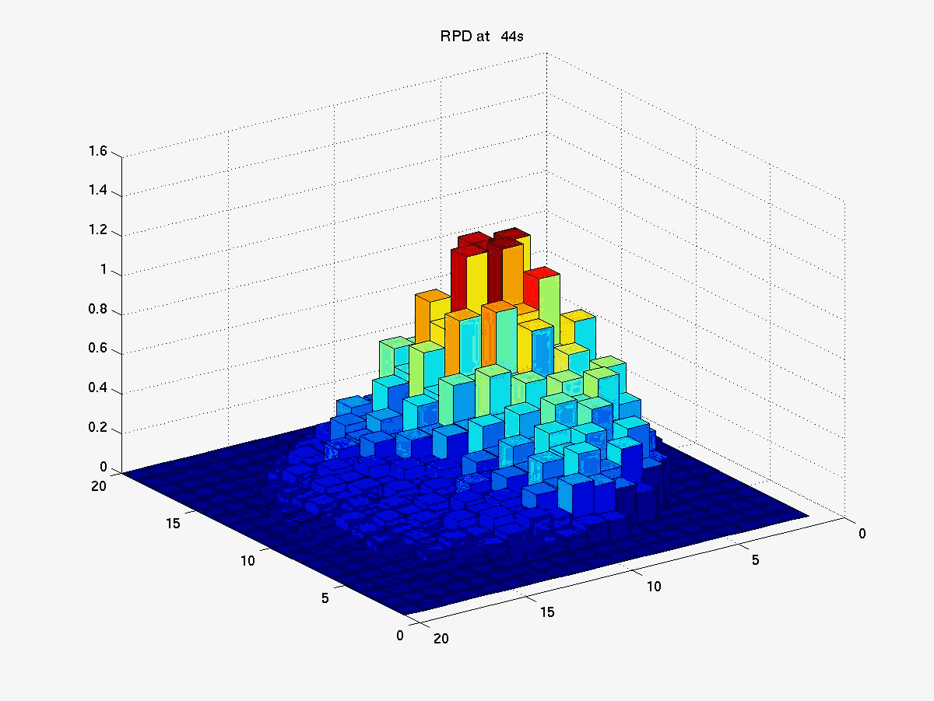

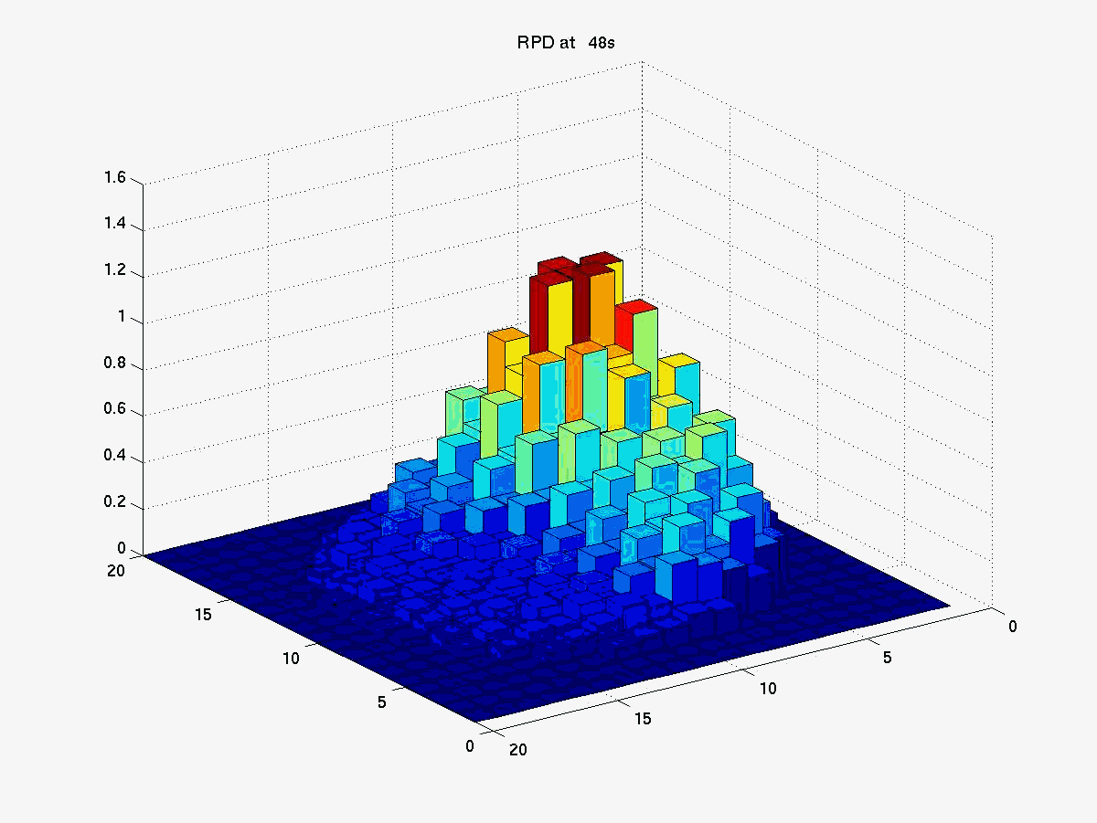








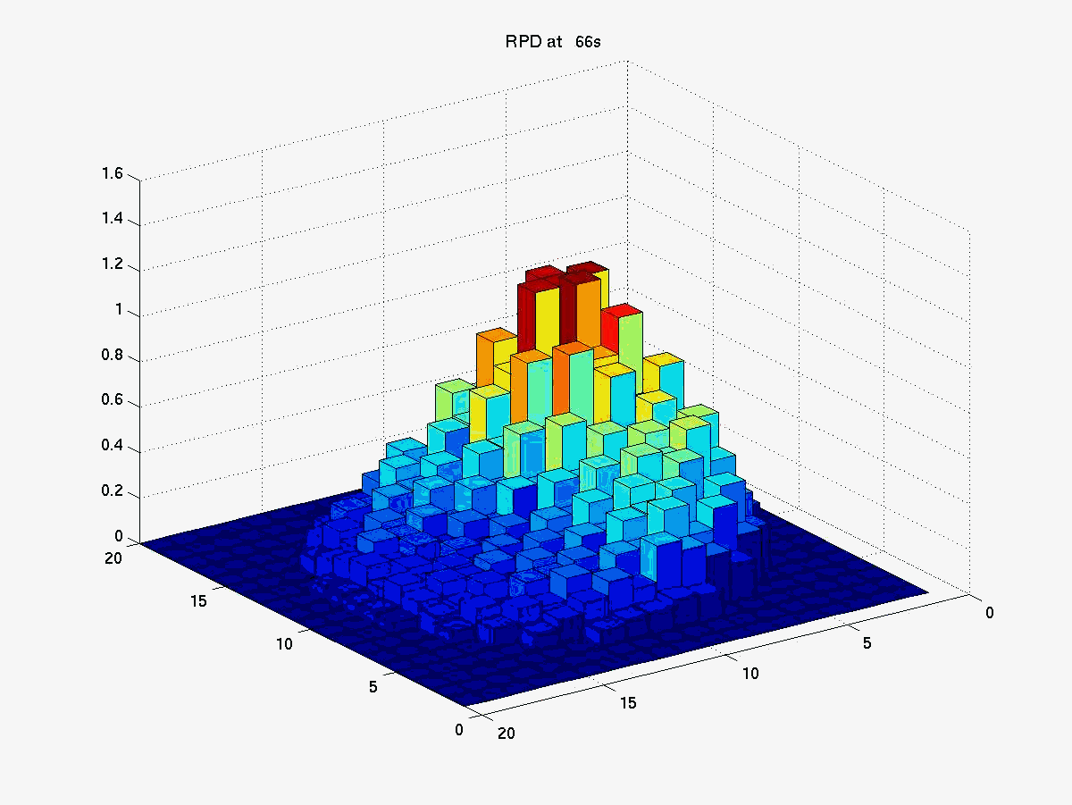


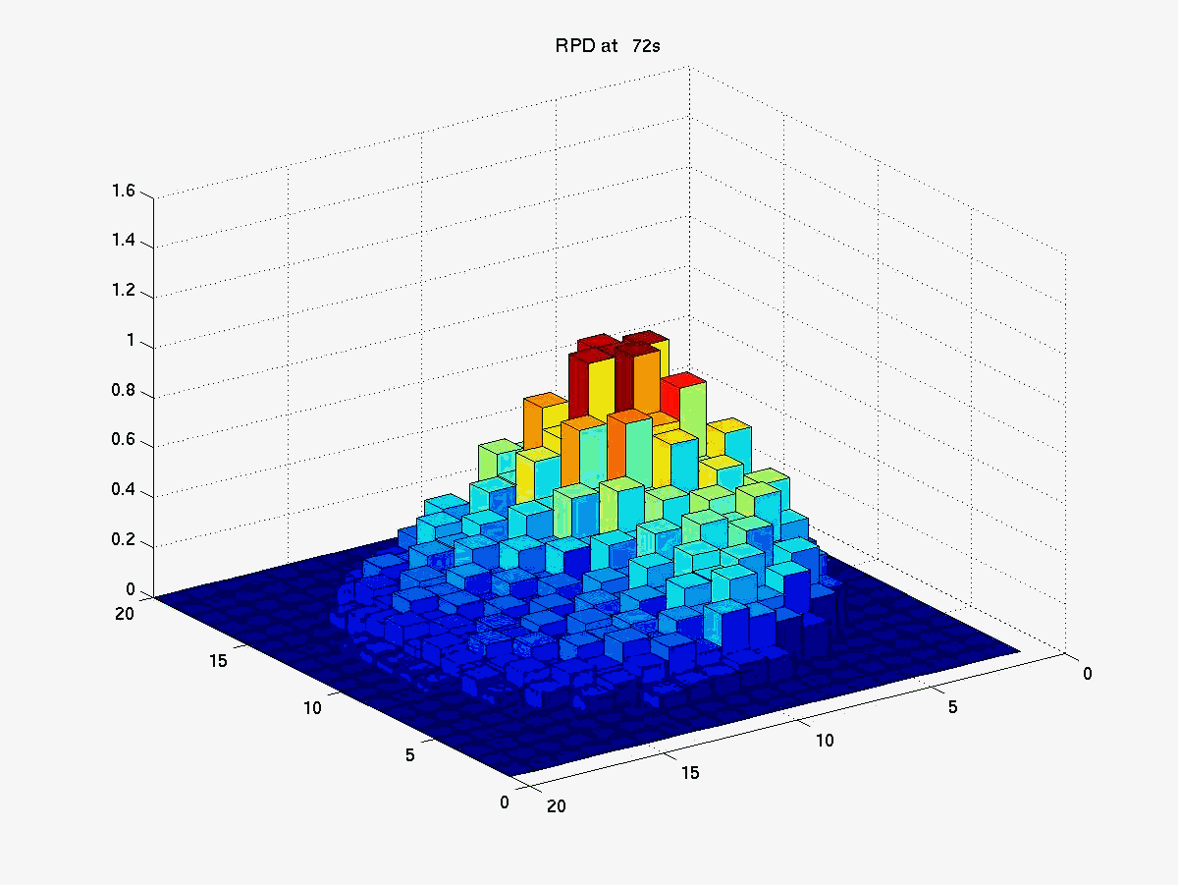
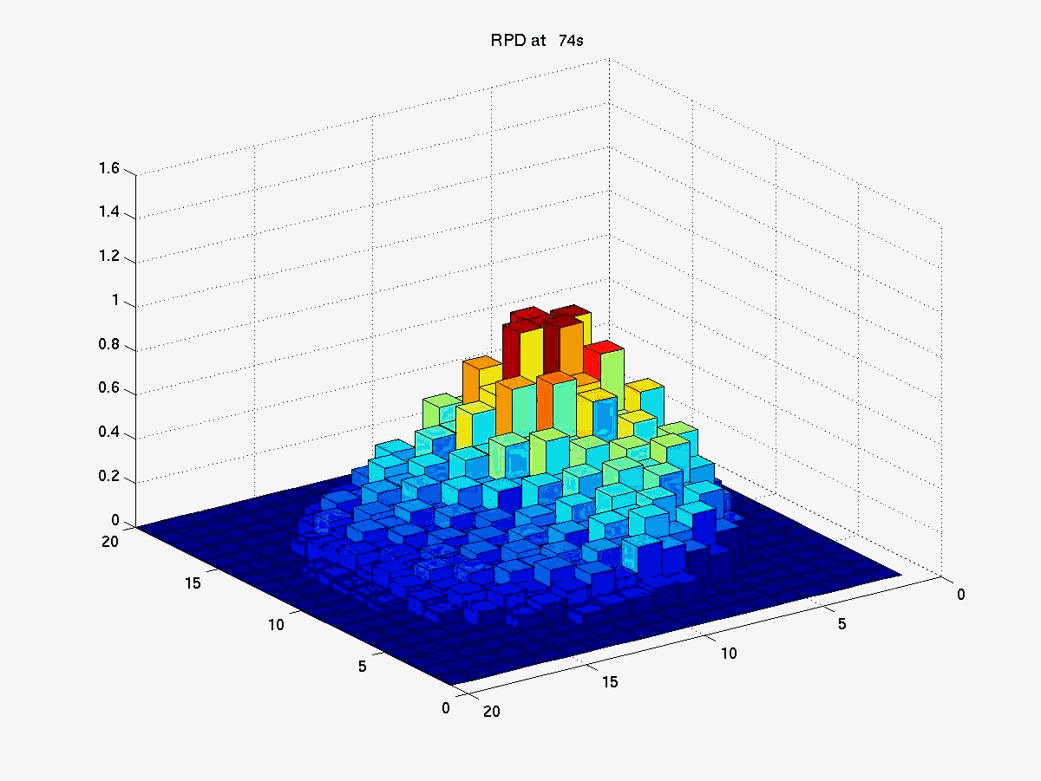



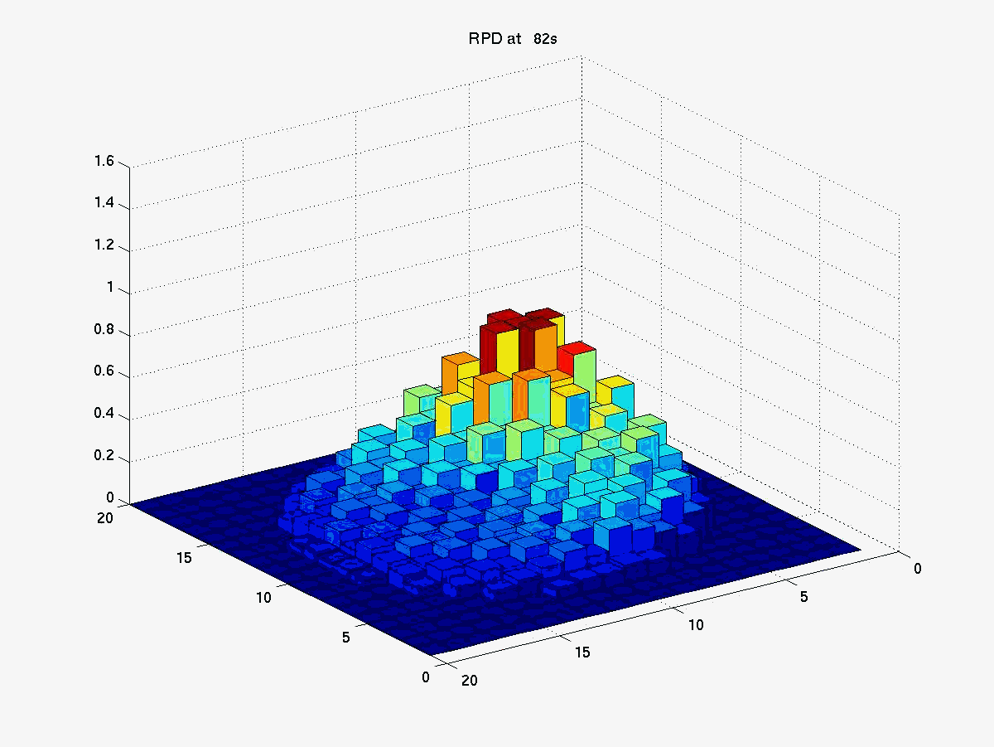
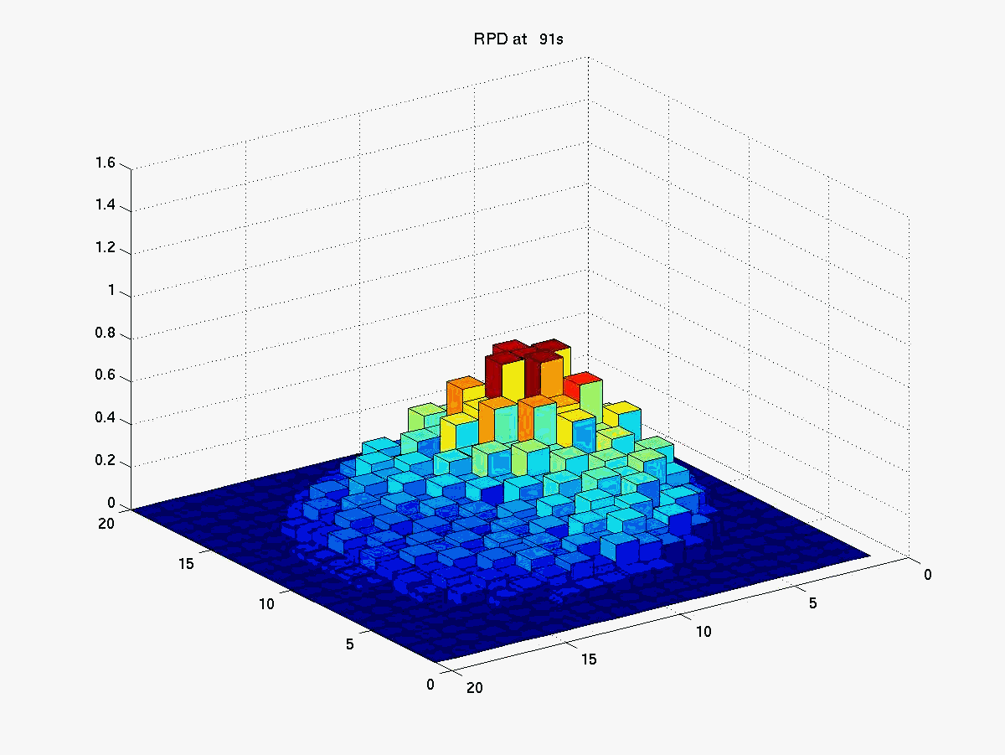
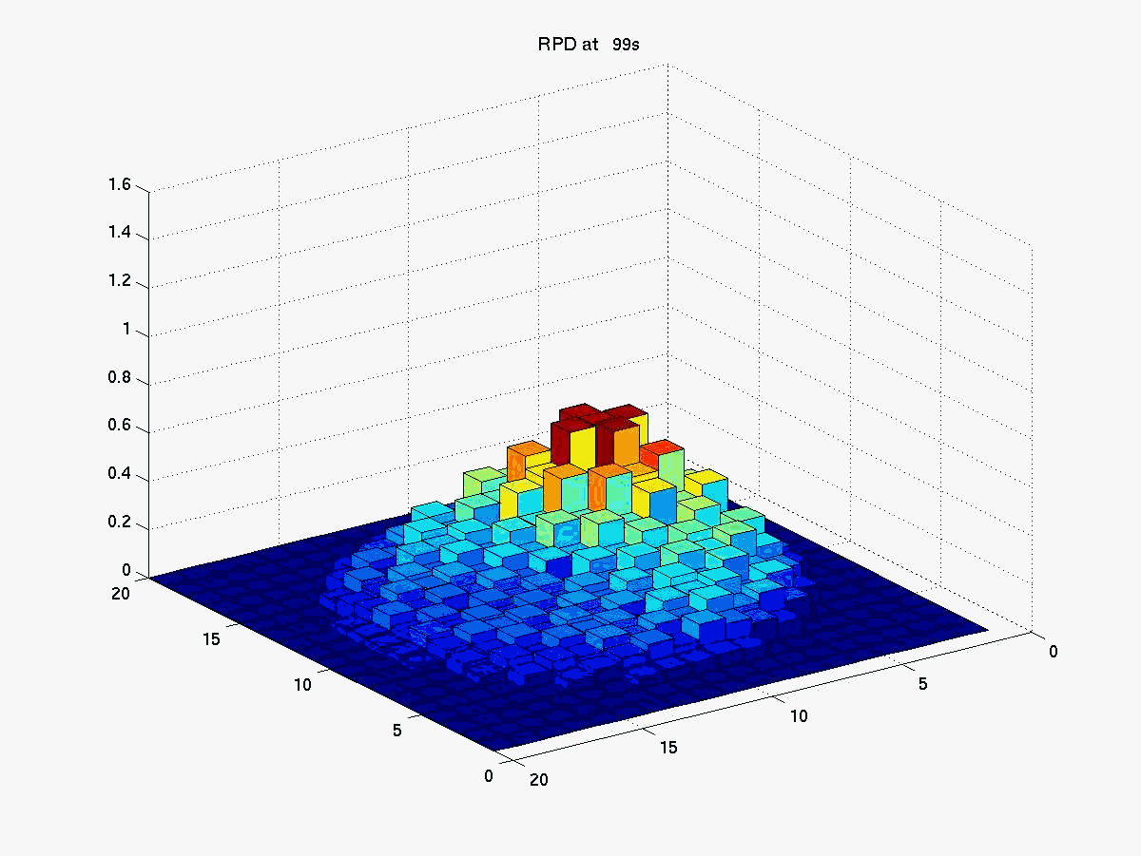
MSLB Transient Analysis
Radial Power Evolution
Notes:
13

Slide 14
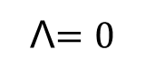
Analysis: Subcritical Source Multiplication
Point Kinetics Equations
Prompt Jump Approximation
Notes:
14

Slide 15
Coupled Neutronics and Thermal-Hydraulics Codes for Reactor Safety Analysis
Pressurized Water Reactor
Control Rod Ejection (Ch 10)
Steam Line Break (Ch 8)
Boiling Water Reactor
Turbine Trip
BWR Stability
High Temperature Gas Reactor
Sodium Fast Reactor

Slide 16
PJA Analytic Solution - 1

Slide 17
PJA Analytic Solution - 2

Slide 18
PJA Analytic Solution - 3

Slide 19
PJA Analytic Solution - 4

Slide 20
PJA Analytic Solution - 5

Slide 21
PJA Analytic Solution - 6

Slide 22
PJA Analytic Solution - 7

Slide 23
PJA Analytic Solution - 8

Slide 24
PJA Analytic Solution – Generalized Asymmetric Ramp

Slide 25
PJA Analytic Solution - Generalized

Slide 26
PJA Analytic Solution - Generalized

Slide 27
Sec 8.2 PJA for Superprompt

